Slide 1
First General Partner Meeting
Next steps
https://www.ai-fora.de

Slide 2
Thanks to team!

Slide 3
Feedback time!

Slide 4
Conference materials available
All slides and other used materials
will be available on the AI FORA website
in a dedicated repository in due course!

Slide 5
Some final thoughts

Slide 6
How to close the gaps in the AI FORA research landscape?
Corona Game to Unemployment Game: We need the rules!
May workshops in Spain and Ireland, other case study countries lined up
Closing the gap between XAI (computer science) and participative approaches (social science) for a comprehensive integrated participatory AI FORA approach
Showing the connection between behavioural modelling and policy modelling
Systematic concept for the AI FORA technological landscape with integration of all components used/produced
Distinguising and reconciling descriptive and normative ethics components in research

Slide 7
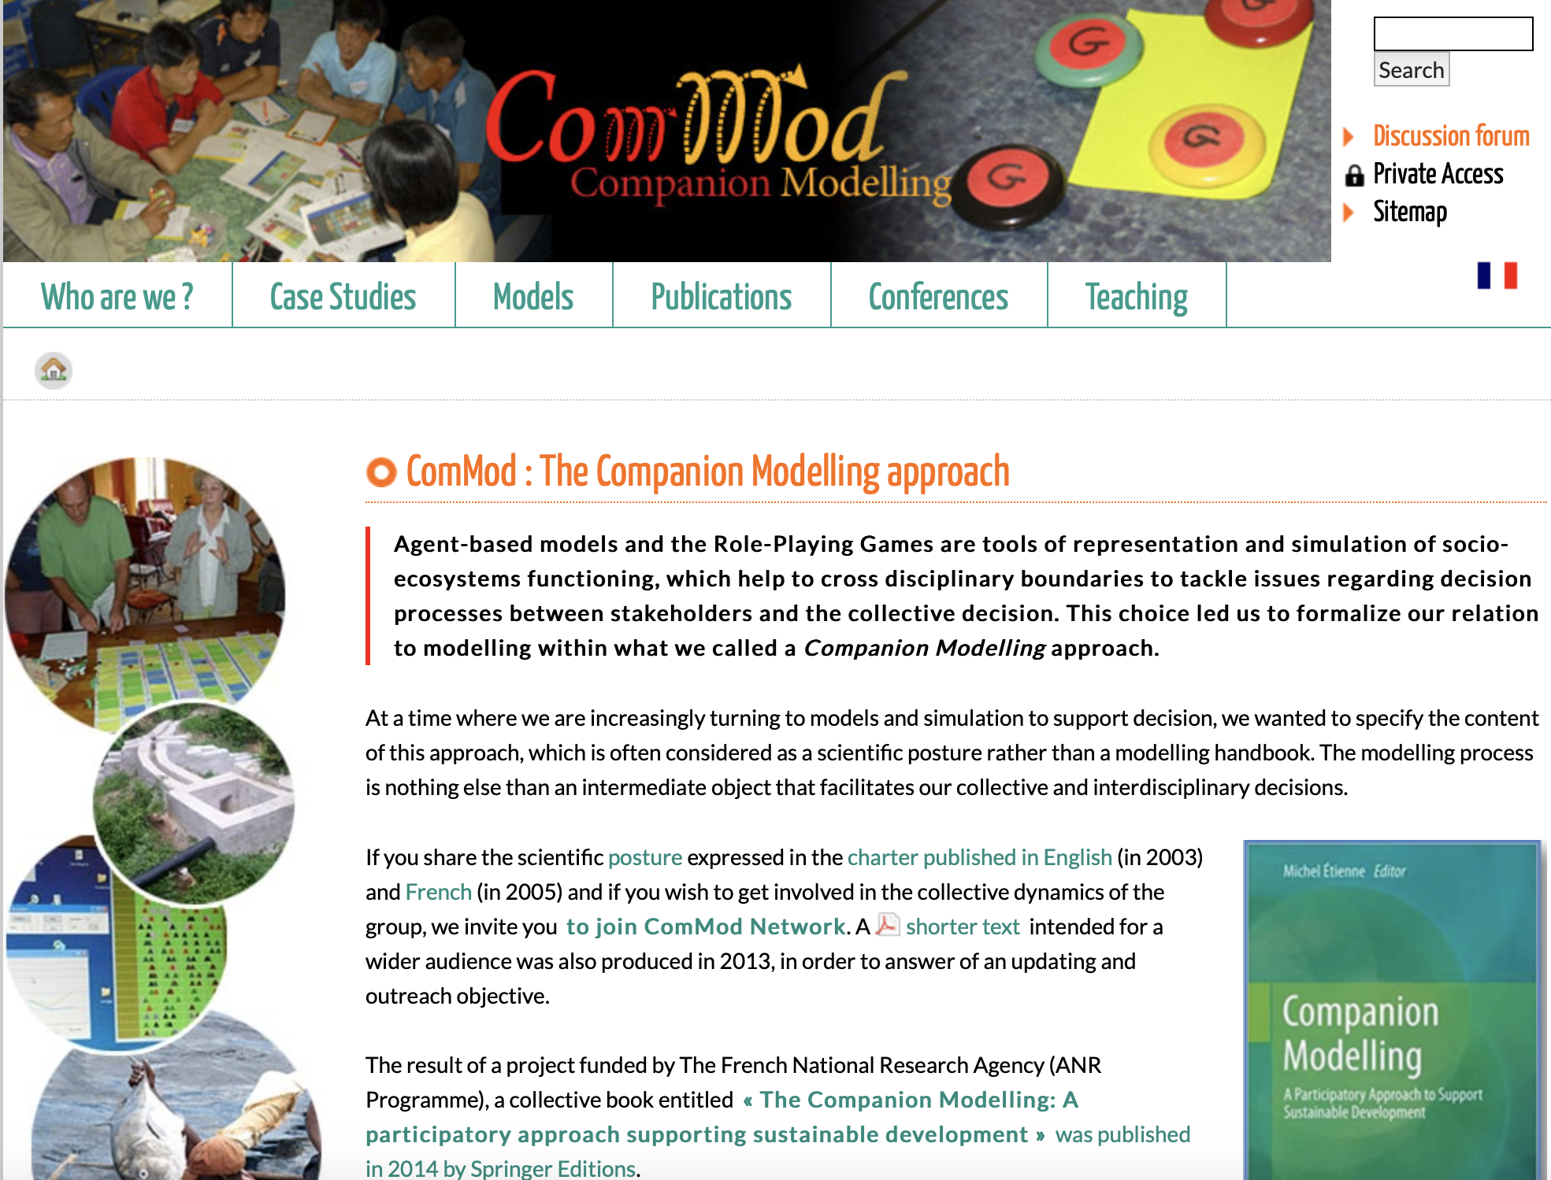
Companion Modelling makes a start
Co-design
Game
Simulation
Barreteau et al. 2013
https://www.commod.org/en

Slide 8
Some next management activities
Science communication full proposal
Making the SAB operational
Sketch out concept for „Global Methods Centre of Participatory Technology Design“
Considering to run an own Safe Space in the middle of Europe (offer from Assisi)

Slide 9
Assisi Inclusive Futures Forum (AIFF)
Dialogue and co-design forum for shaping the future of our societies
Pertinence of Assisi
“Safe Space” for people who aim to work on intercultural conflicts concerning sustainability issues
Cooperation with international research projects on global societal challenges such as climate change, poverty, inequality, technological hazards, and social conflict
Financed by Foundation seconded by R&D projects funded by academia, international organisations dedicated to dialogue, and AIFF’s stakeholder network
Foundation provides the core funding for maintaining the on-site AIFF community, and gives out stipends to students and volunteers
AIFF community is responsible for the acquisition of R&D projects and temporal stakeholder ambassadors joining the community. It provides on-site project support and organizes events and workshops.

Slide 10
Pre-announcement of new AI FORA workshop at central project Safe Space in Assisi, Italy
AI FORA
for Ukraine
The role of AI for global social goods provision in times of crisis: How the world deals with the war in Ukraine
AI FORA partner Oleksandr Khzhniak, Department of Social Sciences, V.N.Karazin Kharkiv National University, Ukraine
Notes:
Shoulder to shoulder of European/Western countries
Value conflicts Freedom-Security etc., own economic stability vs. help (sanction politics) of societies
(Easier handling of) membership issues of supra-national institutions (NATO, EU etc.)
Refugees and migrant policies (issues of citizenship and frontiers)
Shoulder-to shoulder of societal groups (also companies such as oil companies)
Civil society Engagement
Social goods: Food, donations, medical help, military help, refugees and migrants support
De-bureaucratisation
How can technology/AI support? Complex logistics, complex policy problem
• Actors and networks involved on international, national and regional level
Who is interested in co-organising it, is heartily invited. Any support highly appreciated

Slide 11
Targeted publications for the scientific and policy community
Scientific results of AI FORA will be submitted in
two edited volumes
social science outlet for case studies: Springer Nature, already contracted
computer science outlet for technical research
and scientific journals
Slowly starting
Beside publications, also presentations at scientific conferences and their respective proceedings such as AAMAS, SSC, AAAI, or IEEE conferences are central communication channels
Project results will be published in Open Access format by default
Policy Briefs and Policy White Papers summarise co-creation results for the policy community

Slide 12
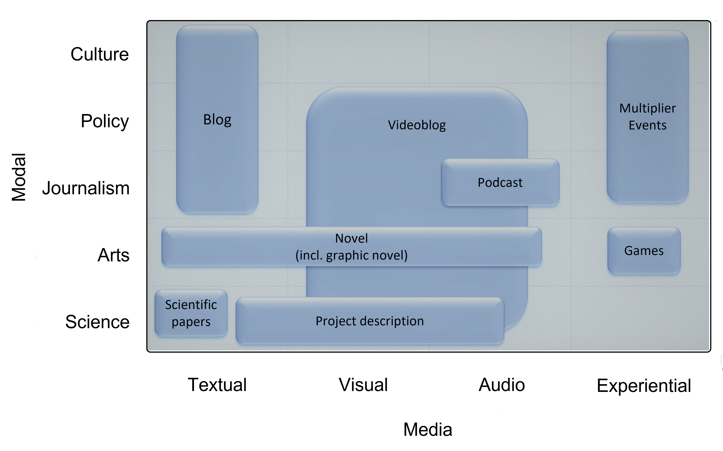
Science communication proposal AI FOR ALL

Slide 13
First General Partner Meeting
The end!
https://www.ai-fora.de

